Slide 1
Creating an Adaptive Environment for Learning, Transitioning…living
by asking the Right Questions
prepared and presented by Jeff Hendricks

Slide 2
What is the purpose of the individual? How do we Assist the individual In discovering their Purpose? Ideas?
?

Slide 3
Career Cluster Values assessment Personality survey The more they discover the more Focused, The more motivated, the more productive they will Be
Somedays it’s hard to
finds you!

Slide 4
Is there dissonance in Your classroom?
In your life?

Slide 5
Dissonance: the lack of agreement between the truth and what people want to believe
What in my thoughts, actions, or feelings are causing dissonance with others?

Slide 6
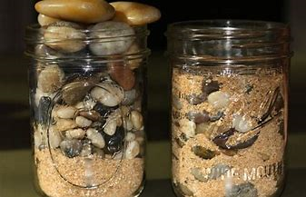
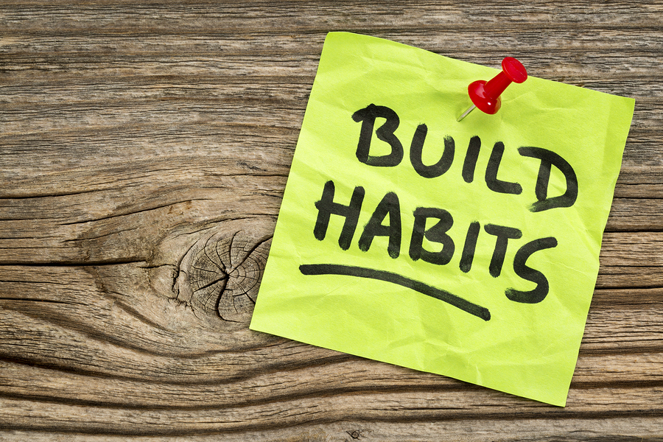
Deconstructing Dissonance
What can I change to make my classroom more harmonious?

Slide 7
Basic Rules for relationships
Unconditional Love
Non-Judgement
Forgiveness
What could have been thought and/or done differently to make the situation feel better?

Slide 8
BIG Bang
Supreme Being
or in between?
What can I respect to bring more peace into my classroom?

Slide 9
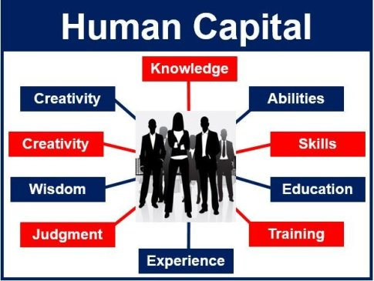
Re-Build or build Human capital
Are my choices adding to my growth and my human capital?

Slide 10
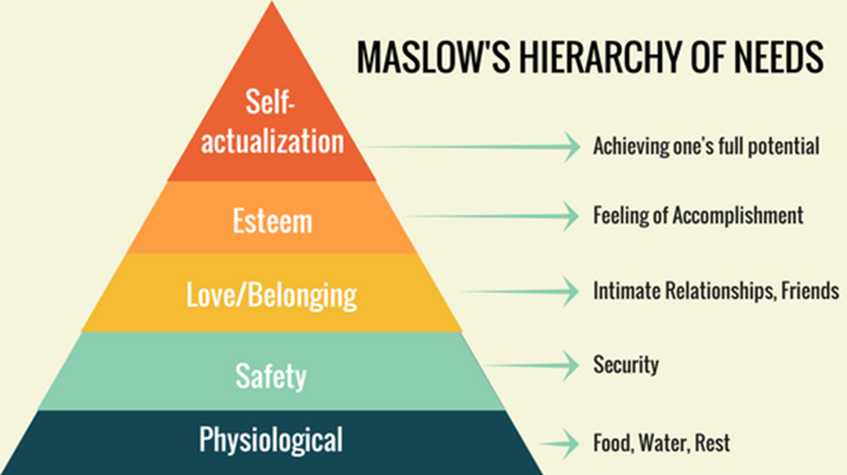
Build upon what we know
=

Slide 11
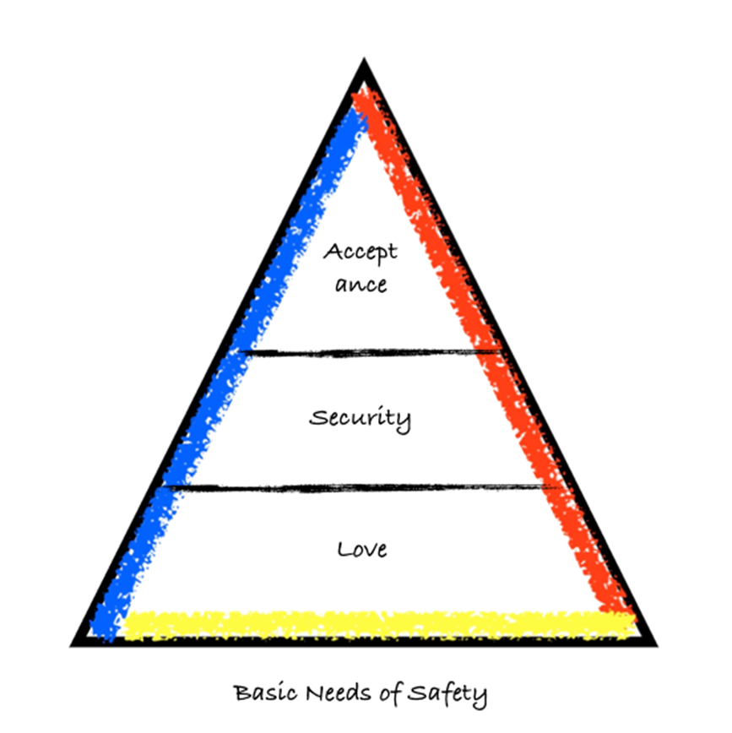
Turning things upside down, Looking all around
+
=

Slide 12
Tap in the best to create flow
Recognizing the Dissonance in Life
Unpack the Maladaptive Behavior
Consider Different Perspectives
Rethink Knowledge Received
Breaking Down Concepts
Relearning Whole Truth
Be Accountable
Tap In and
Flow
or
Choke
on Excuses
Learned Lies
Confusing Concepts
Knowledge of Darkness
Self-Serving Perspectives
Hold On To Maladaptive Behaviors
Try to Comfort the Dissonance in Life
Is this choice adding to a maladapted life? Or Is this choice contributing to joy and harmony?

Slide 13
Create greater Flow for Maximum Potential of Purpose
Each Day Seek Balance of
Mind
Body Service
Emotion
Find Harmony with True
Thinking
Acting Doing
Feeling
What big rocks are choking my flow? What can I work on today to increase my flow?

Slide 14
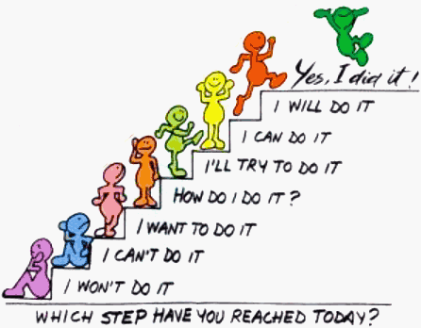
TAP In
TAP IN – The Adaptive Process – Intuition Navigated
Each Day Start Where The Individual Is
Identify What The Individual Needs
What are they missing? – Teach
What maladaptive behaviors are evident? – Re-Teach
What truths do they know and can be built upon? – Empower
Offer – Unpack – Repack – Break It Down – TAP IN
Provide A Picture of The Whole Without the Holes
Show Them The Steps and How To Navigate Them
Nudge of Love – Encourage – Don’t Push
A Hand Up – Invite – Don’t Pull
Anything New Needed?
Clarification Needed?
A chore/task of making a bed, with DEFINED PURPOSE and ADAPTIVE ACTIONS = SELF-EMPOWERMENT
TAP IN any thought, action, or feeling of mind, body, or emotion = HARMONY and JOY of FLOW

Slide 15
May the Force and/or God be with you
What can I do to improve my classroom? My community? How can I change the world?

